Slide 1
File Systems
OPERATING SYSTEMS

Slide 2
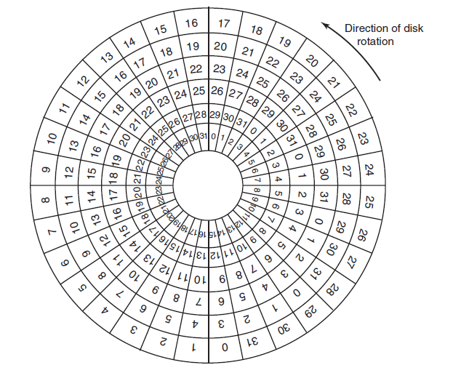
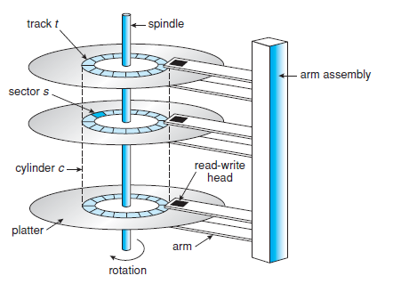
Magnetic Disks/Hard Disks Structure Overview
Provide the bulk of secondary storage for modern computer systems.
Store data permanently.
Hard disk architecture consists of:
Platter
Spindle
Read-write head
Track
Sector
Figure 2: An illustration of platter, tracks and sectors.
Figure 1: Moving-head disk mechanism.

Slide 3
Magnetic Disks/Hard Disks Structure Overview
Disk has multiple platters having circular shape like a CD.
Platters have 2 surfaces upper and lower. Both surfaces are being used.
All the platters are connected with a spindle.
Spindle rotates all platters together unidirectionally in a centric way either clockwise or anti clockwise.
When spindle moves all platters move together.
Actuator arms named read-write heads are connected with every platter.
Read-write heads are connected with both surfaces of platters. Which means a platter having upper and lower surfaces consists of two separate heads for two surfaces.

Slide 4
Magnetic Disks/Hard Disks Structure Overview (cont.)
Purpose of read-write heads is fetching data.
It moves back and forth (backward and forward) in order to read data. As separate heads are connected to every surfaces of a platter that means heads can read data from both surfaces.
Upper and lower both surfaces of a platters consist of same number of multiple tracks.
The outer most track is known as external track and the inner most is known as internal track.
If the heads requires to fetch data from an inner track from its current position, then it needs to move forward.
If the heads requires to fetch data from an inner track from its current position, then it needs to move forward.
If the heads requires to fetch data from an outer track from its current position, then it needs to move backward.
Each track (both upper and lower surface) is divided into fixed number of multiple sectors.
Data is being stored in sectors.

Slide 5
Magnetic Disks/Hard Disks Structure Overview
Problem:
In a disk, there are 8 platters where both upper and lower surfaces are being used. On each surface there are 256 tracks, and 512 sectors are within each track. Each sector can store 512 kb data. What is the total size of disk?
How many number of bits are required to represent the size of the disk?
Solution:
Disk size = # of platters * # of surfaces * # of tracks * # of sectors * size of data a sector can store
= 8 * 2 * 256 * 512 * (512 kb) = 2^3 * 2^1 * 2^8 * 2^9 * (2^9 * 2^10 b) = 2^40 b = 1 tb
Number of bits required = 2^40 b = 40

Slide 6
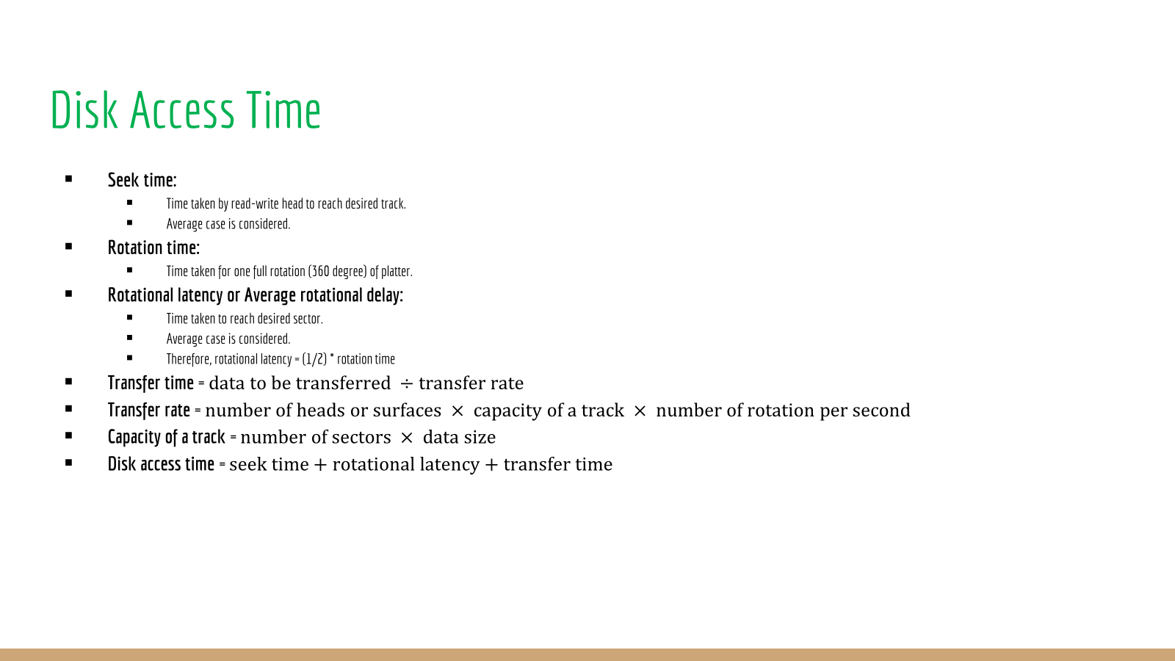

Slide 7
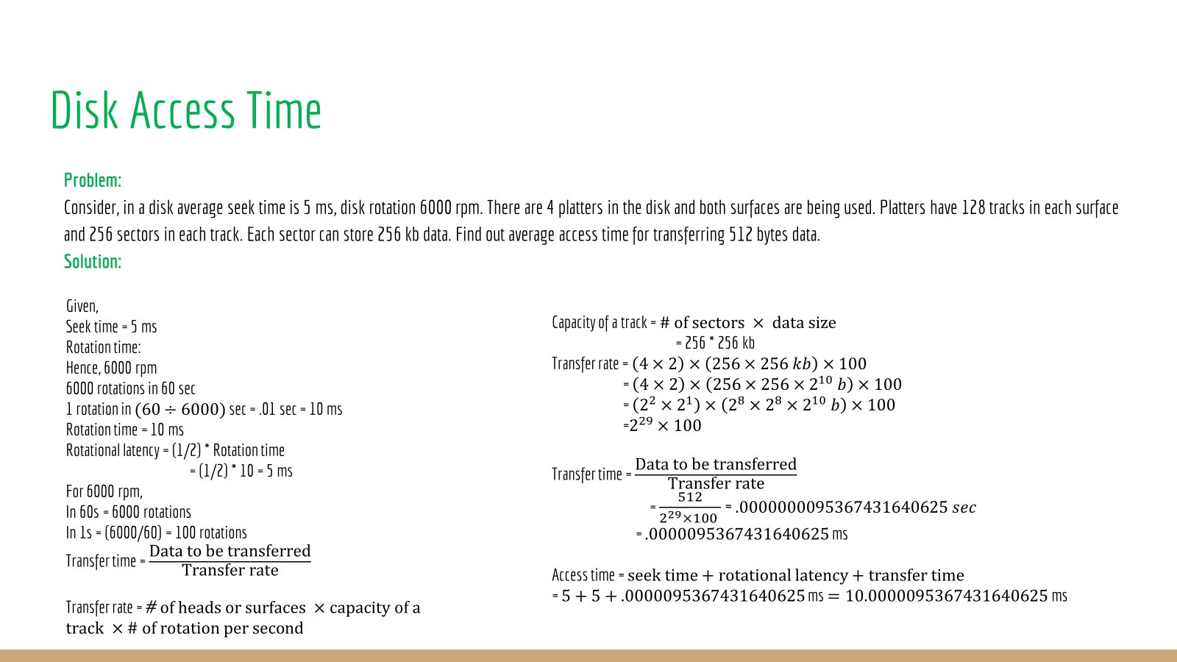

Slide 8
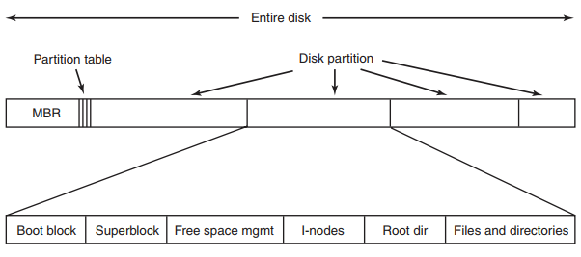
File System Concept
One of the major functionalities of OS.
It is a software component of OS which manages all files.
Different OS has different file systems.
Windows has NTFS, FAT32 etc. file systems, Mac OS has apple file system (APFS), Unix has unix file system (UFS), Linux has extended file systems etc.
It determines how user data in form of files gets stores in the secondary memory or disk permanently and how these data can be fetched from the disk.
Figure: A possible file-system layout.

Slide 9
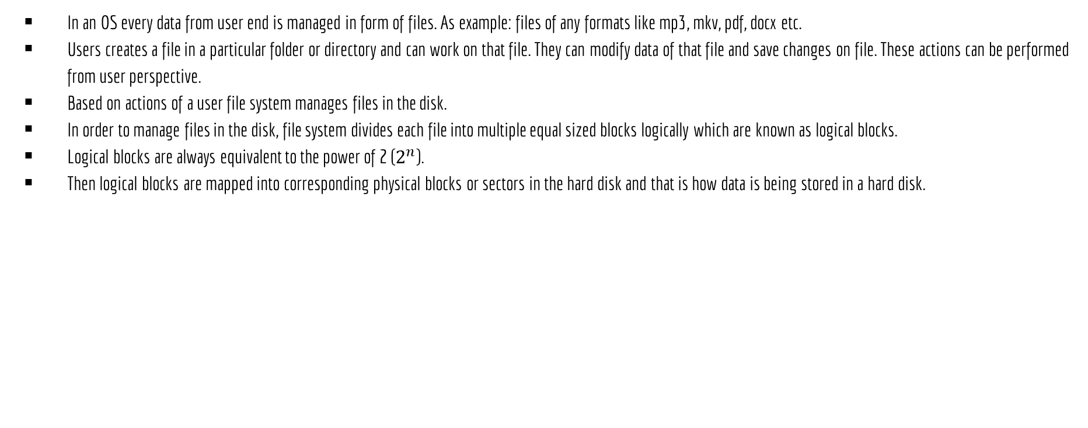
File System Concept (cont.)

Slide 10
File Attributes
Every file in the disk has a name and its data. In addition, all operating systems associate other information with each file, for example, the date and time the file was last modified and the file’s size. These information about the file is known as attributes of the file or metadata. The list of attributes varies considerably from system to system.
Information about files are kept in the directory structure, which is maintained on the disk.
Some of common attributes of files maintained by almost every OS are discussed below:
Name: The symbolic file name is the only information kept in human readable form.
Identifier: This unique tag, usually a number, identifies the file within the file system; it is the non-human-readable name for the file.
Type or Extensions: This information is needed for systems that support different types of files.
Location: This information is a pointer to a device and to the location of the file on that device.
Size: The current size of the file (in bytes, words, or blocks) and possibly the maximum allowed size are included in this attribute.
Protection: Access-control information determines who can do reading, writing, executing, and so on.
Time, date, and user identification: This information may be kept for creation, last modification, and last use. These data can be useful for protection, security, and usage monitoring.

Slide 11
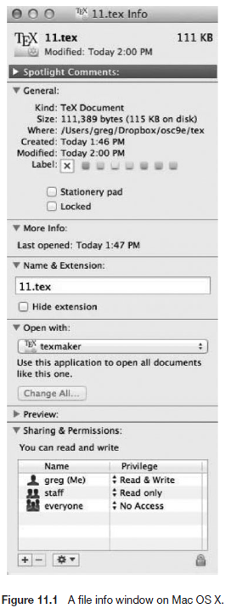
File Attributes

Slide 12
File Operations
Creating: Creates a file with all of its attributes or metadata.
Reading: Reads data from a file.
Writing: Edits or modifies a file.
Deleting: Removes a file alongside its all attributes.
Truncating: Removes information from a file. It does not remove attribute of the file.
Repositioning: Changes the position of the pointer within a file during IO operations.

Slide 13
File Allocation Methods
OPERATING SYSTEMS

Slide 14
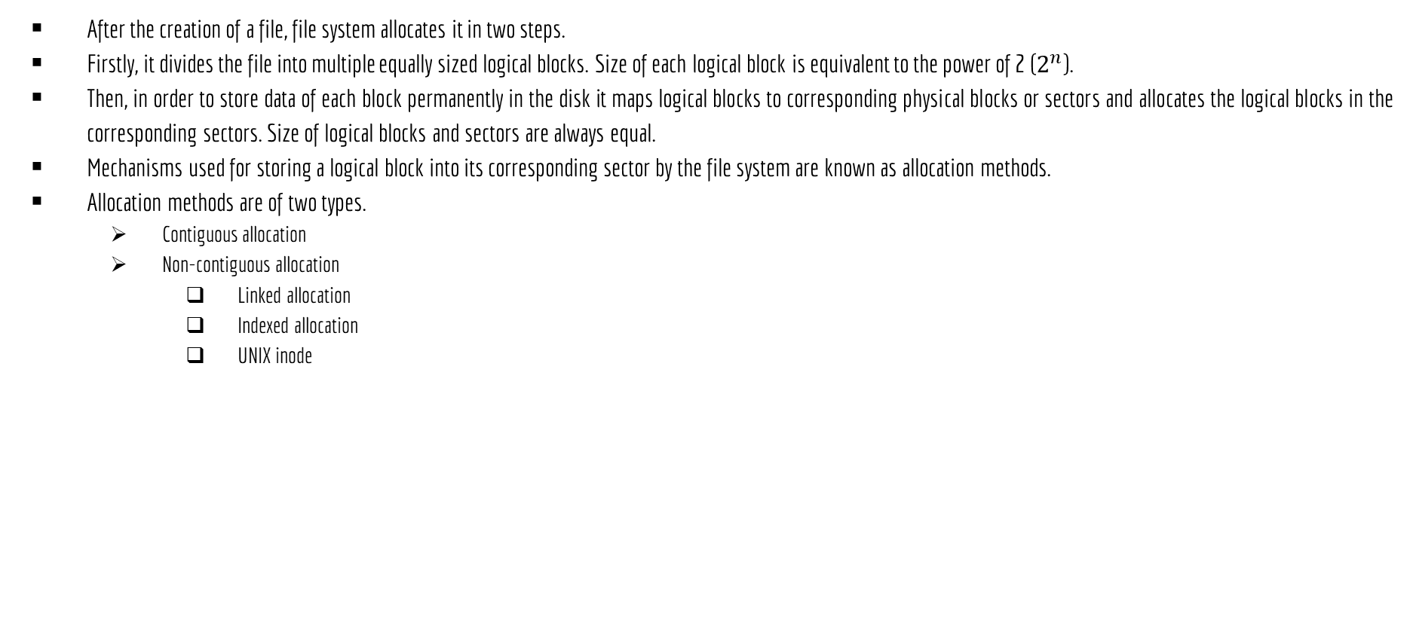
File Allocation Methods

Slide 15
Contiguous Allocation
OPERATING SYSTEMS

Slide 16
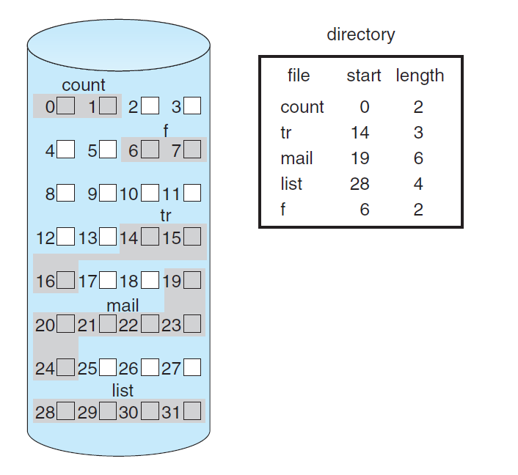
Contiguous Allocation
The simplest allocation scheme is to store each file as a contiguous run of disk blocks. Thus, on a disk with 1 KB blocks, a 50 KB file would be allocated 50 consecutive blocks. With 2 KB blocks, it would be allocated 25 consecutive blocks.
Figure 2: An illustration of platter, tracks and sectors.
Figure 1: Contiguous allocation of disk space.

Slide 17
Contiguous Allocation
Benefits:
Easy to implement.
Due to sequential and direct or random access seek time is better and read performance is excellent.
Faster access time due to random access.
Drawbacks:
Internal and external fragmentations.
Difficult to extend a file.

Slide 18
Non-Contiguous Allocation
OPERATING SYSTEMS

Slide 19
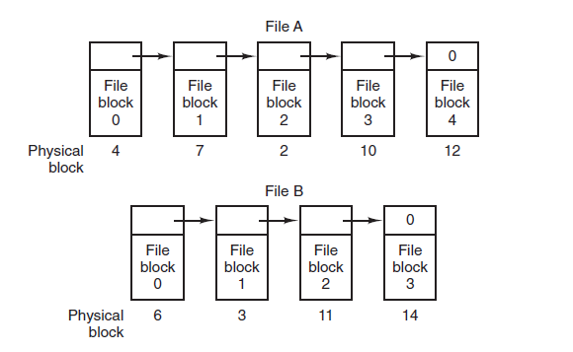
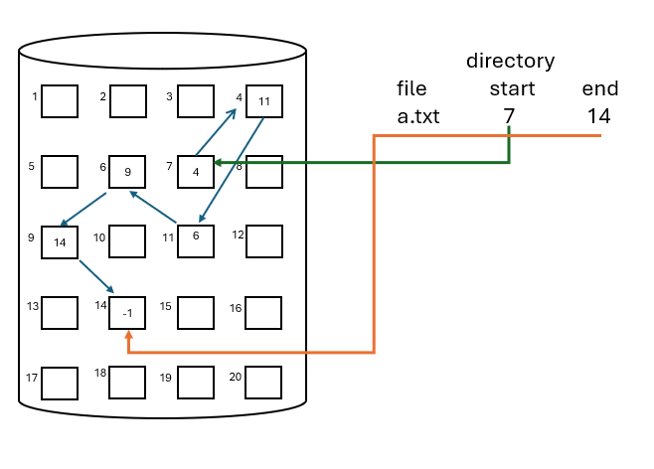
Linked Allocation
Non-contiguous allocation.
Each block consists of 2 fields. One for storing data and another for storing the pointer which indicates address to the next physical block. It follows same mechanism as a linked list.
Disk
Figure 1: Storing a file as a linked list of disk blocks.
Figure 2: Linked allocation of disk space.

Slide 20
Linked Allocation
Benefits:
No external fragmentations.
File size can be easily extended.
Drawbacks:
No random or direct access.
Large seek time.
Overhead of pointers.

Slide 21
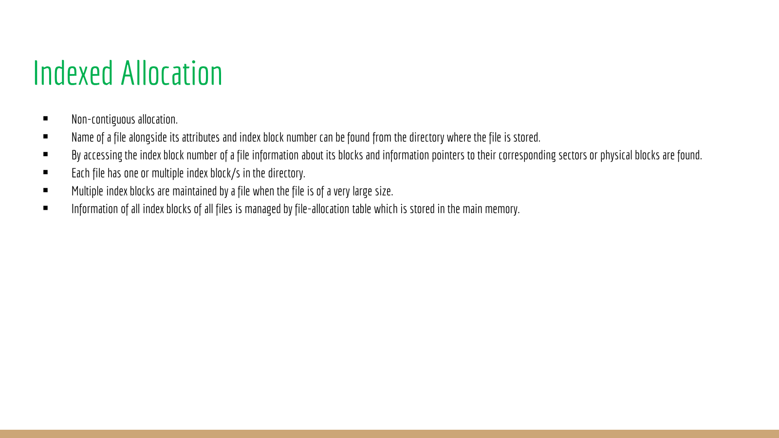

Slide 22
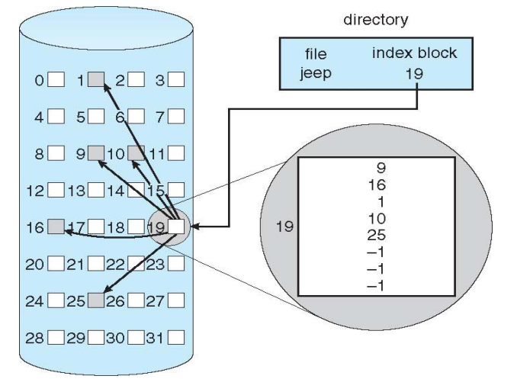
Indexed Allocation
Figure: Indexed allocation of disk space.

Slide 23
Indexed Allocation
Benefits:
Supports random or direct access.
No external fragmentations.
Drawbacks:
Pointer overhead.
Multilevel index when file is too large.

Slide 24
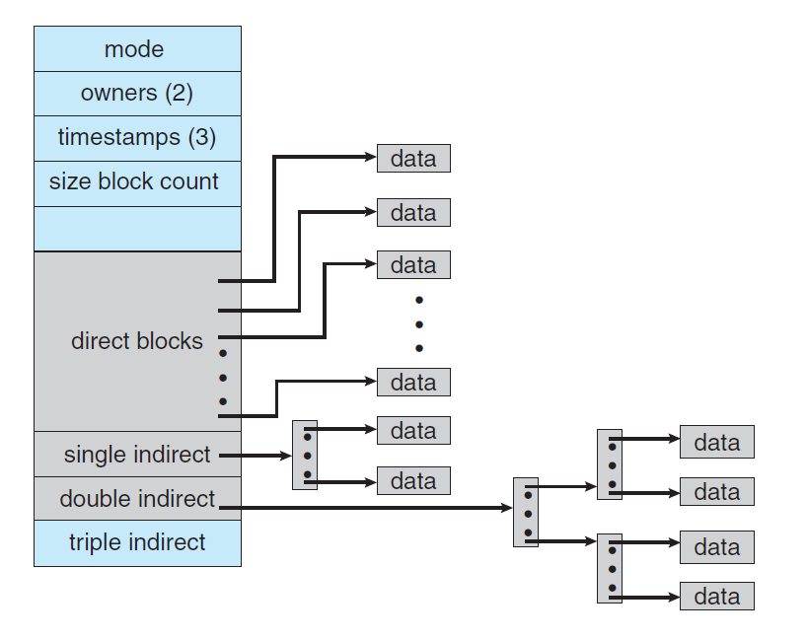
UNIX Inode
Variant of indexed allocation.
I means indexed and node means block.
It maintains multilevel index.
UNIX inode is a custom data structure consists of file attributes, direct blocks, single indirect, double indirect and triple indirect fields.
Direct blocks: Stores such data blocks where each block stores pointer to a block where data is stored.
Single indirect: Stores such data blocks where each block stores pointer to a direct block.
Double indirect: Stores such data blocks where each block stores pointer to a single indirect.
Triple indirect: Stores such data blocks where each block stores pointer to a double indirect.
Figure: The UNIX inode.

Slide 25
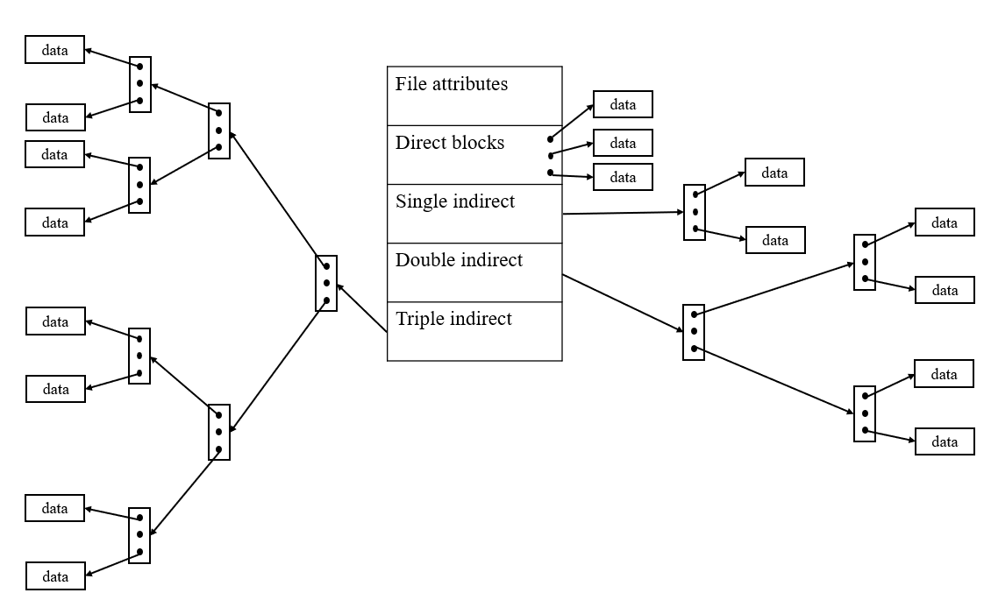
UNIX Inode
Figure: The UNIX inode with detailed triple indirect.

Slide 26
